Slide 1
DeviceNet
Presenter: Elahe Mortazavian

Slide 2
Table of contents
Introduction OSI Model Common Industrial Protocol Controller/Device Connection Conclusion

Slide 3
01
Introduction

Slide 4
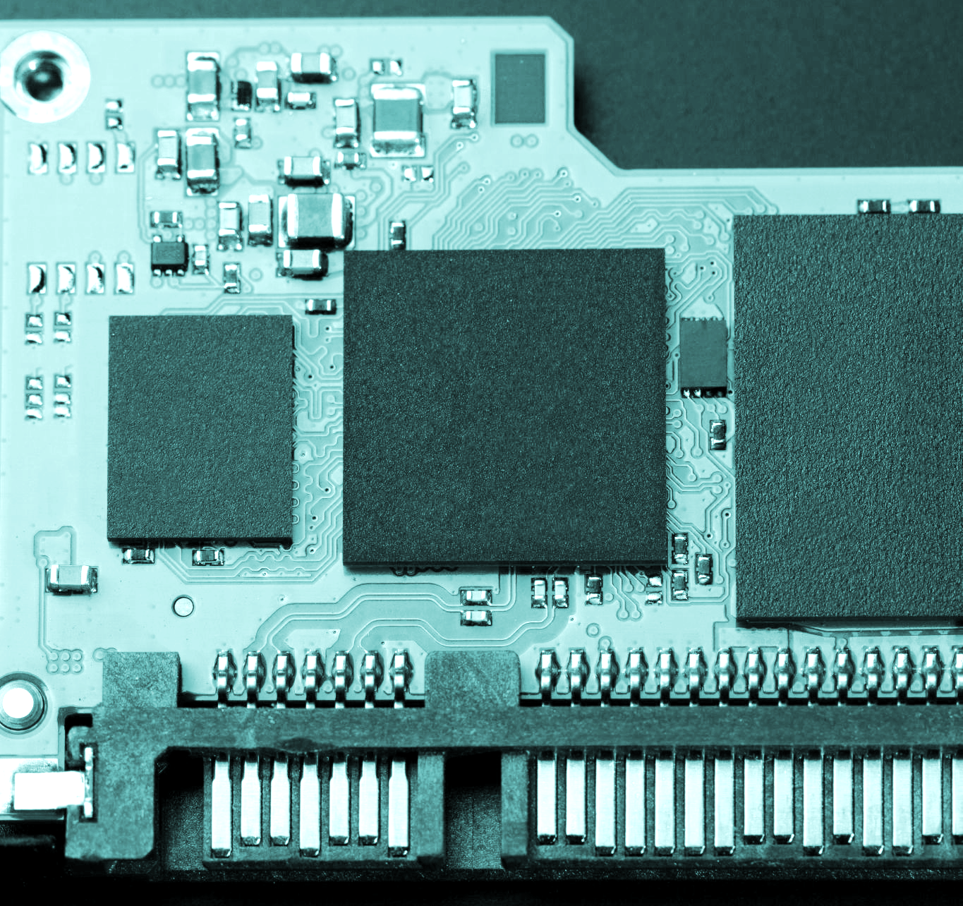
What is DeviceNet?
An industrial network protocol based on CAN (Controller Area Network) technology.
Part of the CIP (Common Industrial Protocol) family
Used in manufacturing automation for control, diagnostics, configuration, and data collection

Slide 5
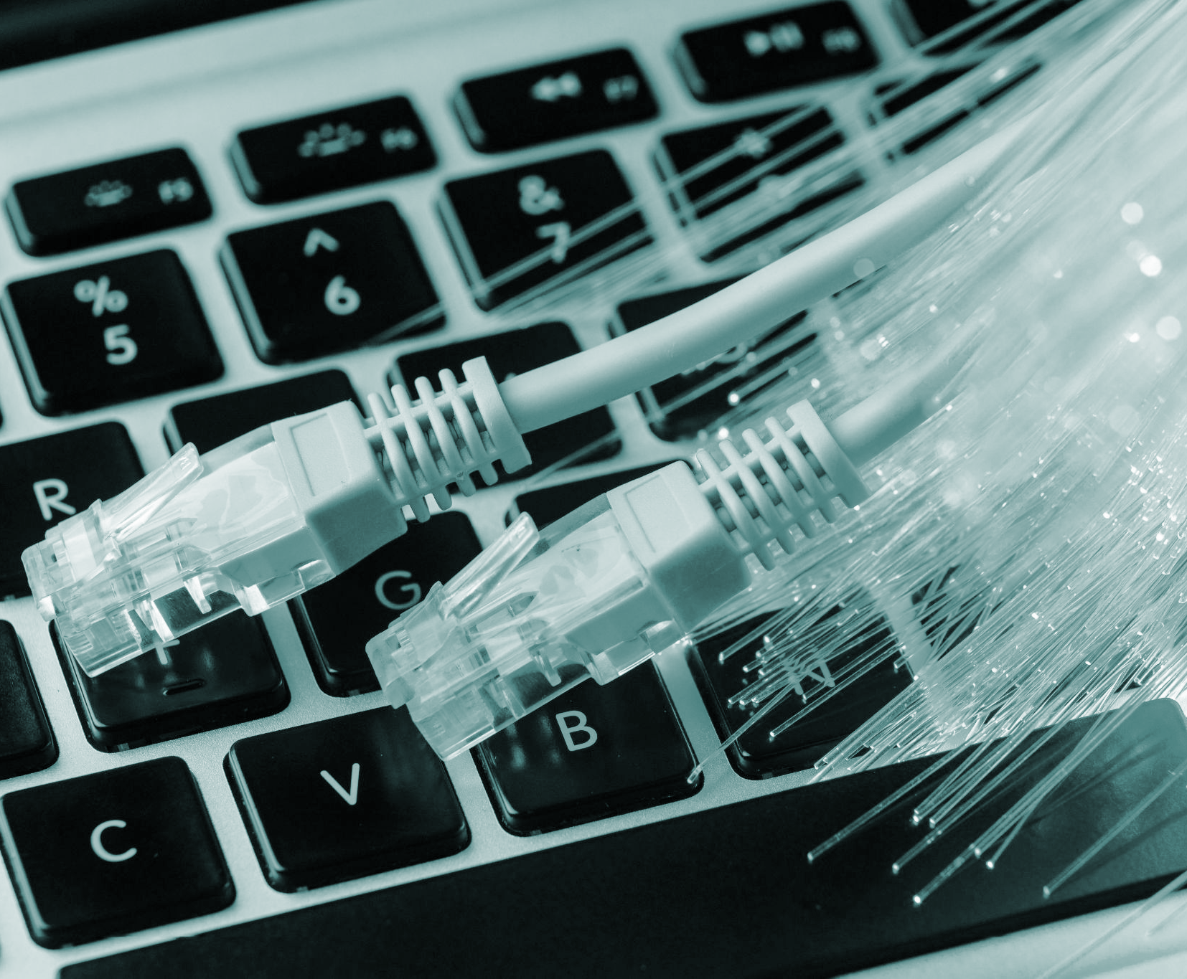
Advantages
Some advantages of DeviceNet are as follows:
Control & data exchange over a single network
Supports up to 64 nodes and baud rates up to 500 kbps
Robust in industrial environments with flexible topology
Power & signal on the same wire

Slide 6
OSI Model
02

Slide 7
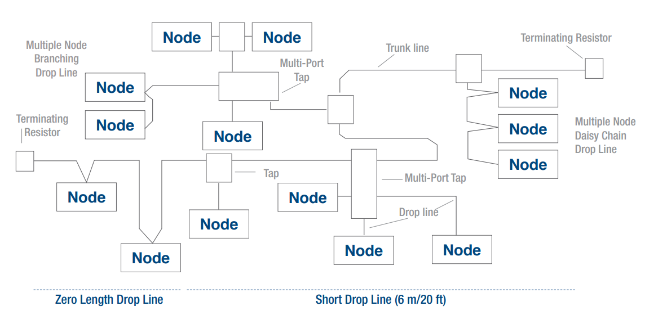
Physical Layer
Incorporates a trunkline-dropline topology
Use of separate twisted pair buses for both signal and power distribution
Supports three possible data rates
Using shared bus in order to save space and reduce wiring complexity

Slide 8
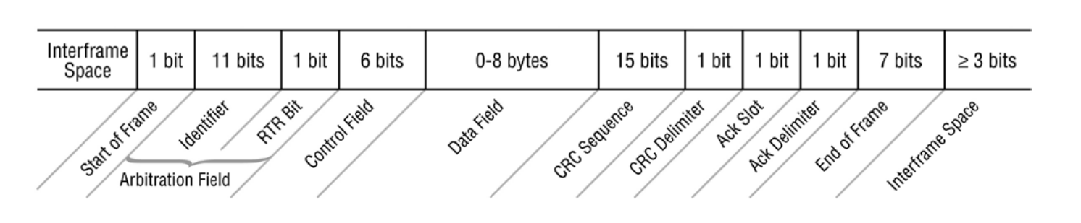
Data Link Layer
uses standard, unmodified CAN
DeviceNet uses primarily only the data frame

Slide 9
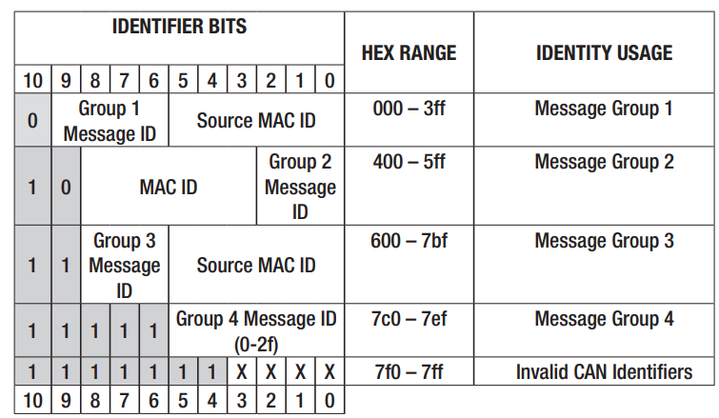
Network and Transport Layer
DeviceNet is a connection-based network
Using a Producer-Consumer model
DeviceNet supports two types of messages: Explicit and Implicit
Utilizing DeviceNet Fragmentation for data bigger than eight bytes.

Slide 10
Common Industrial Protocol
03

Slide 11
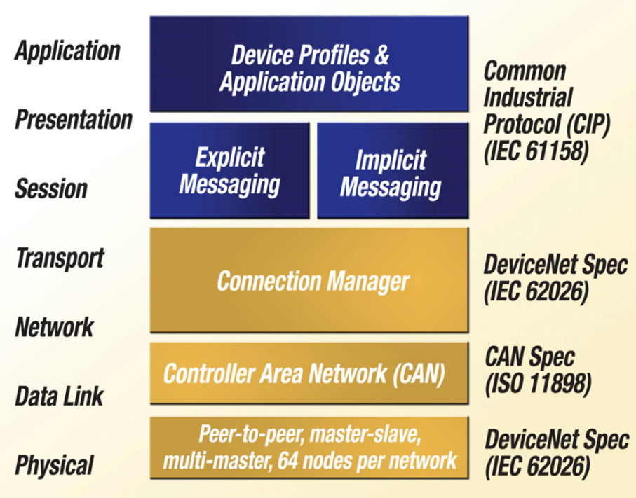
Common Industrial Protocol
Used in upper layers
An object-oriented protocol
A producer-consumer communication model
Includes device profiles
Seamless bridging and routing

Slide 12
Controller/Device Connection
04

Slide 13
Predefined Controller/ Device Connection Set
Simplifies the packaging and the movement of data contained in the I/O messages
Provides connection objects that are almost entirely configured at the time the device powers-up
The message type used is determined based on how the device is configured and the requirements of the application
Types of I/O messages: Polled, Cyclic and Change-of-state

Slide 14
Conclusion
05

Slide 15
Conclusion
DeviceNet is a proven, flexible, and efficient industrial network
Enables real-time communication in manufacturing environments
Still widely used despite the rise of industrial Ethernet solutions

Slide 16
References
https://scadahacker.com/library/Documents/ICS_Protocols/ODVA%20-%20DeviceNet%20-%20CIP%20on%20CAN.pdf
https://www.embien.com/industrial-insights/a-comprehensive-guide-to-odva-devicenet-protocol
https://www.odva.org/wp-content/uploads/2021/05/PUB00026R5_Tech-Series-DeviceNet.pdf
https://www.rtautomation.com/technologies/devicenet/?srsltid=AfmBOor9PYyAzcOueZ2aIAmgdghhdzgZNiKAi_S6VT4y_wUexdJtf230
https://www.odva.org/technology-standards/key-technologies/common-industrial-protocol-cip/
https://www.rtautomation.com/rtas-blog/what-is-cip/?srsltid=AfmBOooS4oUYnexu3ZchB5GXZzQVU8PDs1VNa2vAju7zC8L2ws2oOiPc

Slide 17
Thank You!

